Slide 1



Household money is scattered everywhere
THE PROBLEM
Paper bills
Dollar subscriptions
Small daily spends
CEB, CWA and my.t bills arrive on paper, each with its own due date and late fee.
Netflix, Spotify and iCloud charge in US dollars, so the real rupee cost is hard to see.
Fuel, groceries and the odd coffee add up, and no single place keeps count.
Rs 41,870
Rs 10,480
Rs 7,120
spent by the average household every month
a month on food and groceries
a month on housing bills, phone and internet
Source: Statistics Mauritius, Household Budget Survey 2023 (preliminary results)
Notes:
Here’s the problem. The average Mauritian household spends Rs 41,870 a month, according to Statistics Mauritius’s 2023 Household Budget Survey: over Rs 10,000 on food and groceries and over Rs 7,000 on housing bills, phone and internet. That money is scattered. Paper bills from CEB, CWA and my.t each have a different due date and a late fee if you miss it. Streaming and cloud subscriptions are billed in dollars, so nobody really knows what they cost in rupees. And the small daily spends, fuel, groceries, a coffee, never get written down. Budgeting apps built for other countries don’t understand our bills, our providers or our prices.

Slide 2
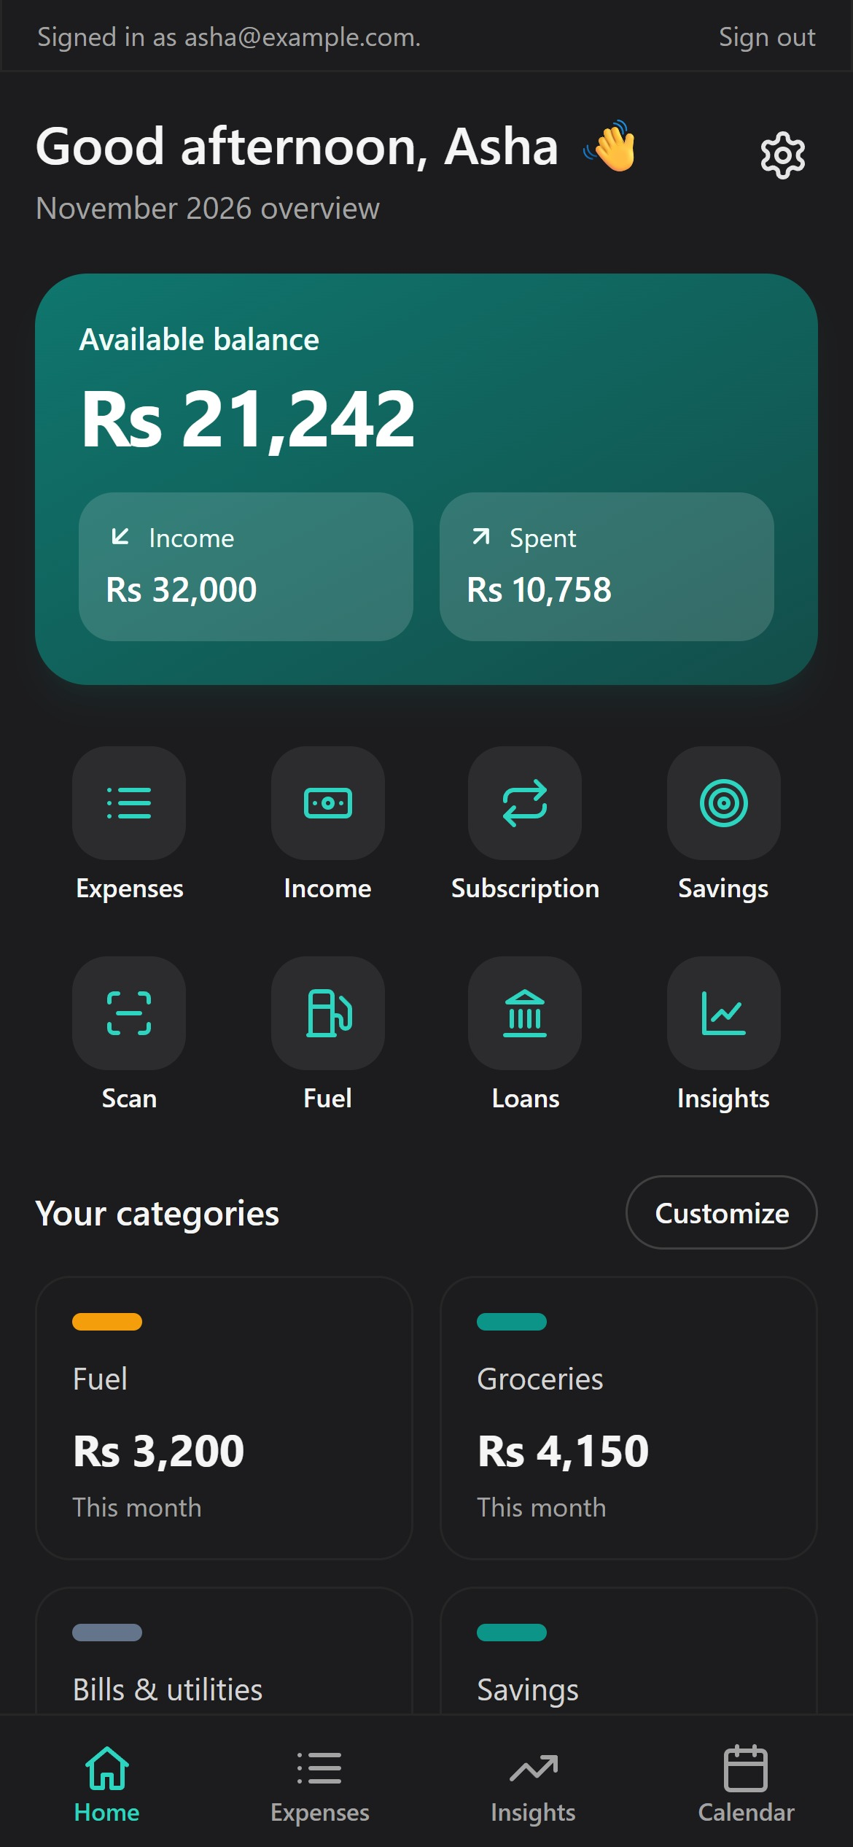
ZeBudget
HACKATHON 2026 · TEAM ZECRYPTROME
Every rupee, sorted.
The budget tracker built for Mauritian households: scan your CEB, CWA and my.t bills, track subscriptions in rupees and see where your money really goes.
Live demo: https://nkhilesh.github.io/Zecryptrome/
Notes:
Good [morning]. We’re team Zecryptrome, and this is ZeBudget: a budget tracker built for how Mauritian households actually spend money. In the next few minutes: the problem, what ZeBudget does, a quick look at bill scanning, how it’s built, how we handled the Hostile Network challenge, and where we take it next.

Slide 3
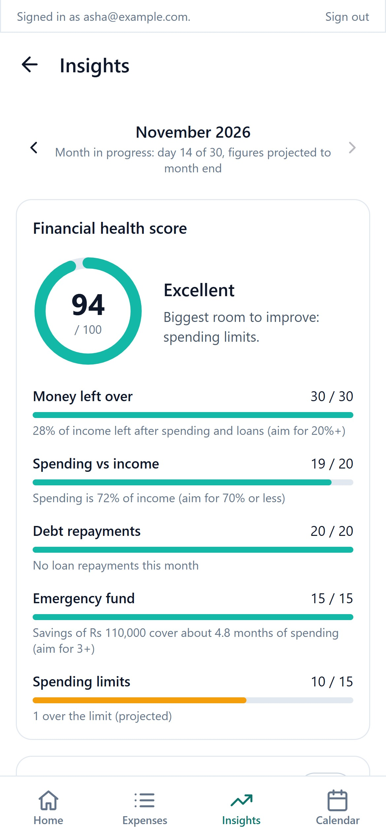






One app for every rupee
THE SOLUTION
Quick add
Bill scanning
Item and price, one tap. Category picked for you.
Photo in, amount and due date out.
Subscriptions
Fuel cost
21 services priced in rupees, renewals logged automatically.
Google Maps distance × your car’s consumption.
Insights
Joint account
Health score, forecast and a national comparison.
Share one budget with your partner.
Notes:
ZeBudget brings all of it into one mobile app. Add an expense in two taps: type the item and price, and ZeBudget picks the category. Scan a bill and it fills itself in. Subscriptions come with real Mauritian prices, converted to rupees, and every renewal is logged automatically. The fuel calculator uses Google Maps to price a journey for your actual car. Insights give you a health score out of 100, a month-end forecast, and a comparison with the national Household Budget Survey. And you can share one budget with your partner as a joint account.

Slide 4
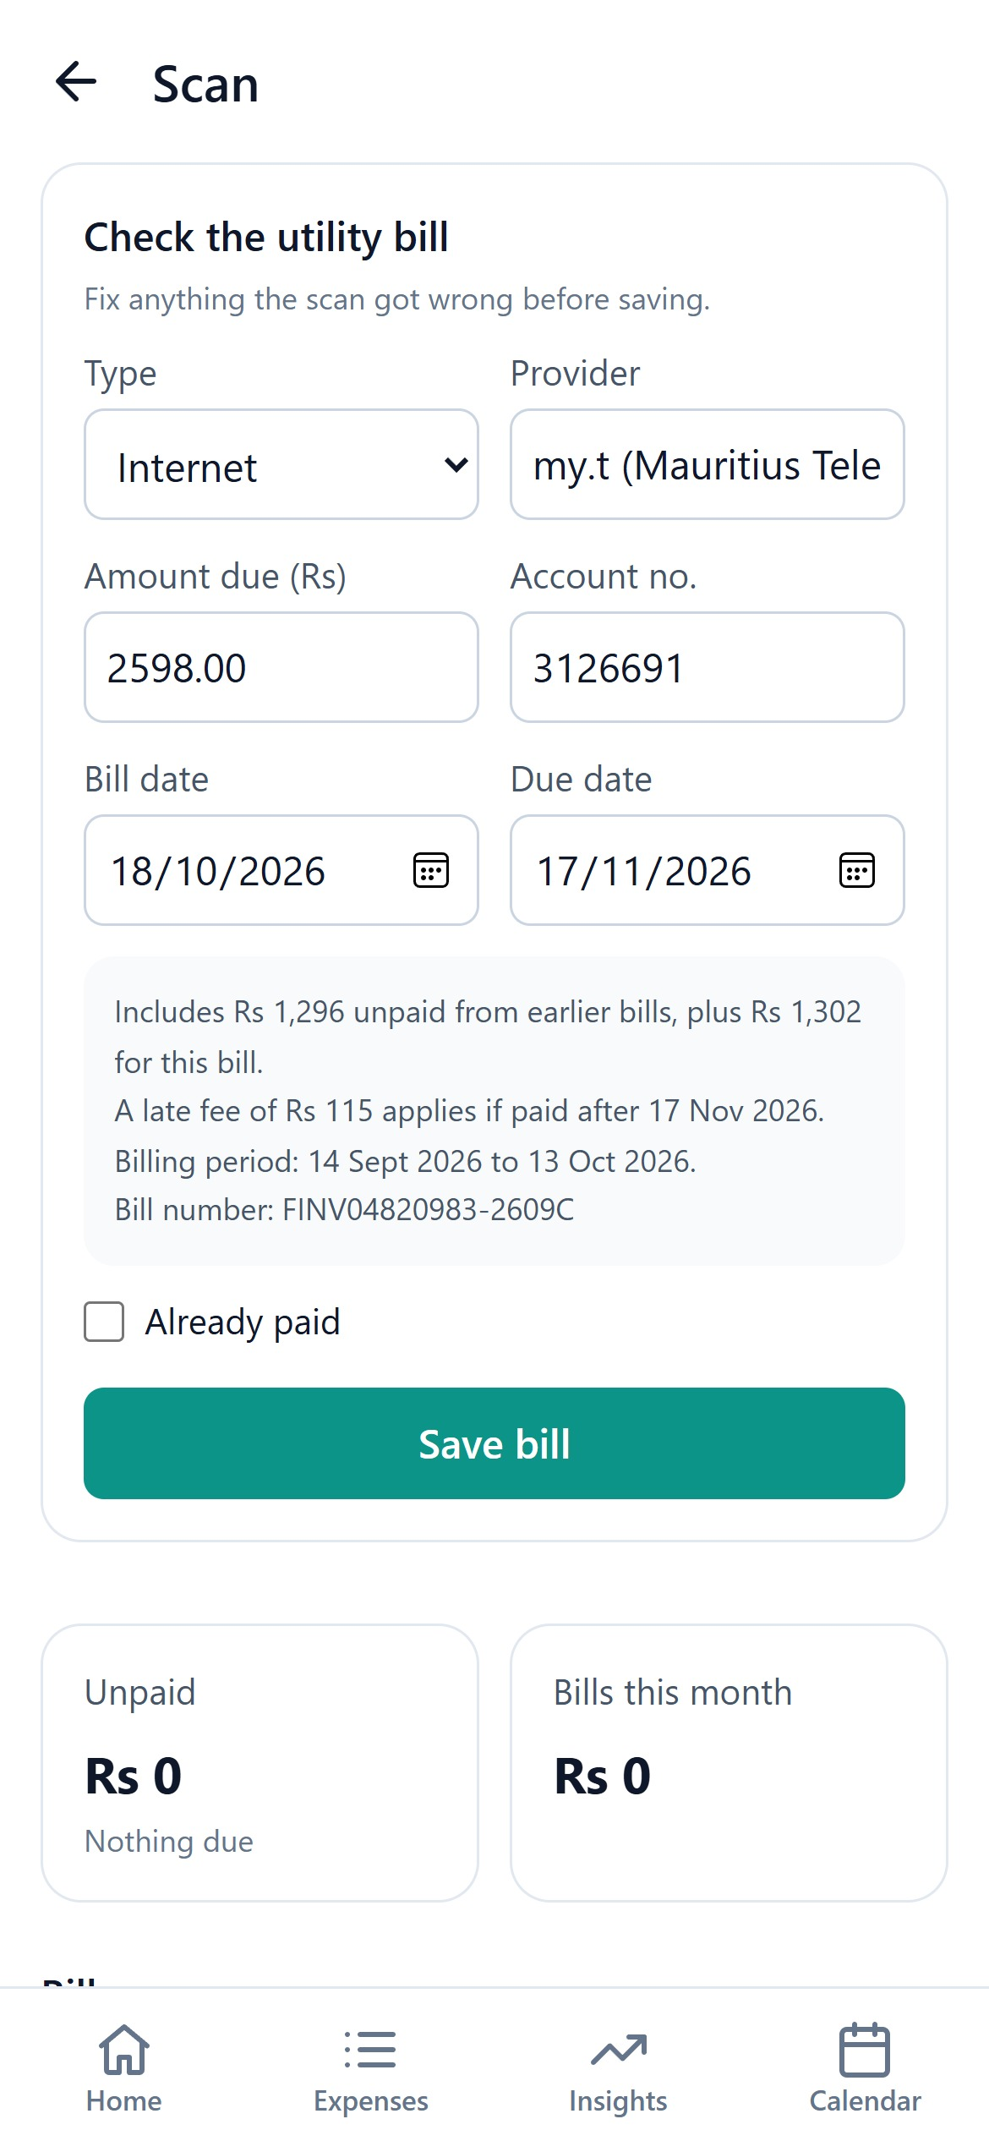
Snap a bill. ZeBudget does the rest.
STANDOUT FEATURE
1
Take a photo of a CEB, CWA or my.t bill
2
Google Vision reads it, with on-device reading as a backup
3
Amount, due date and late fee are filled in, ready to check
Rs 2,598
17 Nov
Rs 115
Amount due
Due date
Late fee if missed
Notes:
This is the feature we’re proudest of. You photograph a bill, and Google Cloud Vision reads it. If Vision is unavailable, ZeBudget reads the photo on the device instead. Then our parser, written for Mauritian bills, pulls out what matters. On a real my.t bill it found Rs 2,598 due, that this includes Rs 1,296 unpaid from last month, the 17 November deadline, and the Rs 115 surcharge if you pay late. The bill then shows up in your spending and on the calendar.

Slide 5
The Hostile Network
SURPRISE CHALLENGE CARD
The rule: assume someone is intercepting or tampering with what the app sends. Protect data in transit and make tampering harder.
The weak point we found
Bill scanning sent each photo from the phone straight to Google, with our Google Vision API key in the page and in every request. Anyone watching the traffic or reading the code could copy it.
What we changed
Photos now go over HTTPS to our own Supabase Edge Function, with the user’s signed session token. The key lives on the server as a secret, and the function calls Google itself.
Why it’s harder to exploit
There’s no key on the phone or on the network to steal. And every data request is checked by row-level security, so a tampered request can’t read or change someone else’s budget.
Notes:
Midway through the hackathon we drew a surprise restriction: the Hostile Network card. Assume someone is intercepting or tampering with what the app sends, find one weak point, and make it harder to exploit. Our weak point was bill scanning: the phone called Google Vision directly, so the API key sat in the page and travelled with every request. Anyone on the same Wi-Fi or reading the code could copy it and run up our bill. We moved that call behind a Supabase Edge Function. The phone now sends the photo over HTTPS with the user’s signed session token, the key stays on the server as a secret, and the function talks to Google. Nothing secret is left on the phone or on the network, and because every data request is checked by row-level security, a tampered request still can’t touch another person’s budget.

Slide 6
A mobile web app, secure by design
HOW IT’S BUILT
App
Data & accounts
Mobile-first web app
Supabase
Installs to the home screen, works on any phone, light and dark themes.
Sign-in, Postgres with row-level security, joint accounts via server functions.
Bill reading
Made for Mauritius
Google Cloud Vision
Local knowledge
Called through a Supabase Edge Function, so the API key never reaches the phone.
CEB, CWA, my.t and Emtel bills, Canal+ packs, rupee prices, Google Maps routes.
Notes:
Under the hood, ZeBudget is a mobile-first web app, so it runs on any phone and installs to the home screen without an app store. Accounts and data live in Supabase: Postgres with row-level security, so each person only ever sees their own budget, and joint accounts go through server functions. Bill reading uses Google Cloud Vision through an Edge Function, which keeps our API key off the phone. And the part nobody else has: local knowledge, from Mauritian bill formats to Canal+ packs and rupee pricing.

